Slide 1

Summarization and Sentiment Analysis On Hindi and English Language
BY:-
Vishal Jagadale (230940128014)
Pooja Patil (230940128017)
Suhas Kolekar (230940128030)
Madan Vaka (230940128034)
Pooja Pawar (230940128018)

Slide 2
TABLE OF CONTENTS
INTRODUCTION
SYSTEM ARCHITECTURE
DATA PRE-PROCESSING
MODEL ARCHITECTURE
TRAINING WORKFLOW
PREDICTION WORKFLOW
TOOLS AND TECHNOLOGY
RESULTS
DEPLOYMENT
FUTURE SCOPE
CONCLUSION

Slide 3
INTRODUCTION
Our project focuses on developing an application utilizing advanced machine learning for text summarization and sentiment analysis in Hindi and English. We utilize transformer-based models like GPT2 and BART, known for their semantic understanding, for summarization. For sentiment analysis, we employ the FLAIR library, renowned for its accuracy. Supporting multiple languages, our application caters to diverse users, offering insights in their preferred dialects. This project showcases AI's potential in simplifying text analysis, making it invaluable for businesses, researchers, and individuals dealing with textual data.

Slide 4
1. TEXT SUMMARIZATION
A process of condensing large bodies of text into shorter versions while retaining key information.
It aims to provide a concise overview of the main points and essential details.
It involves analyzing the text's content, identifying important ideas, and presenting them in a more manageable format.
There are two main types: extractive, which selects and rearranges existing sentences, and abstractive, which generates new sentences to capture the essence of the text.
Widely used in various applications such as news aggregation, document summarization, and information retrieval to save time and effort for readers.

Slide 5
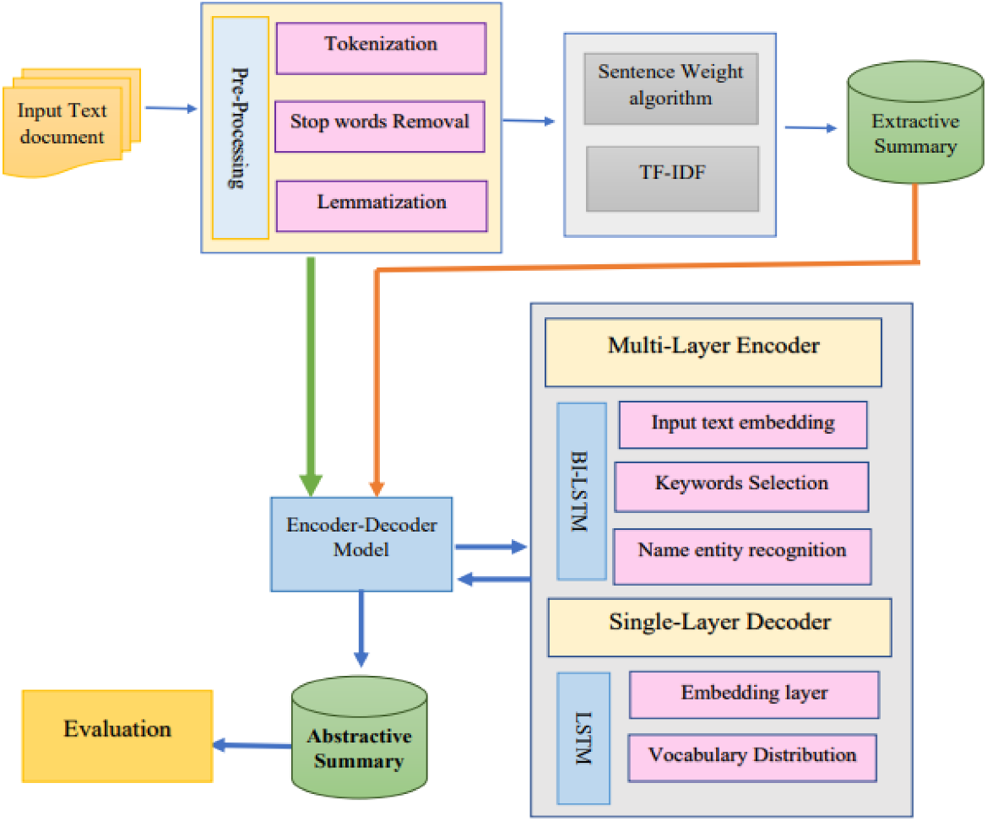
SUMMARIZATION FLOWCHART

Slide 6
2. SENTIMENT ANALYSIS
The process of determining the emotional tone behind a piece of text, such as whether it's positive, negative or neutral.
It involves using algorithms and natural language processing techniques to analyze the sentiment expressed in written content.
Sentiment analysis helps businesses and organizations understand customer opinions, feedback, and attitudes towards their products or services.
It can be used to monitor social media, customer reviews, surveys, and other sources of text data to gauge public sentiment.

Slide 7
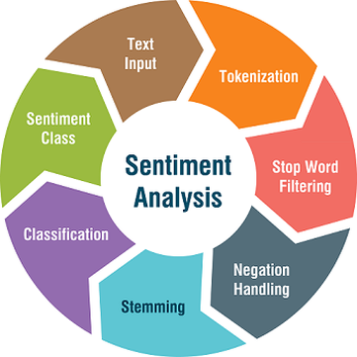
SENTIMENT ANALYSIS FLOWCHART

Slide 8
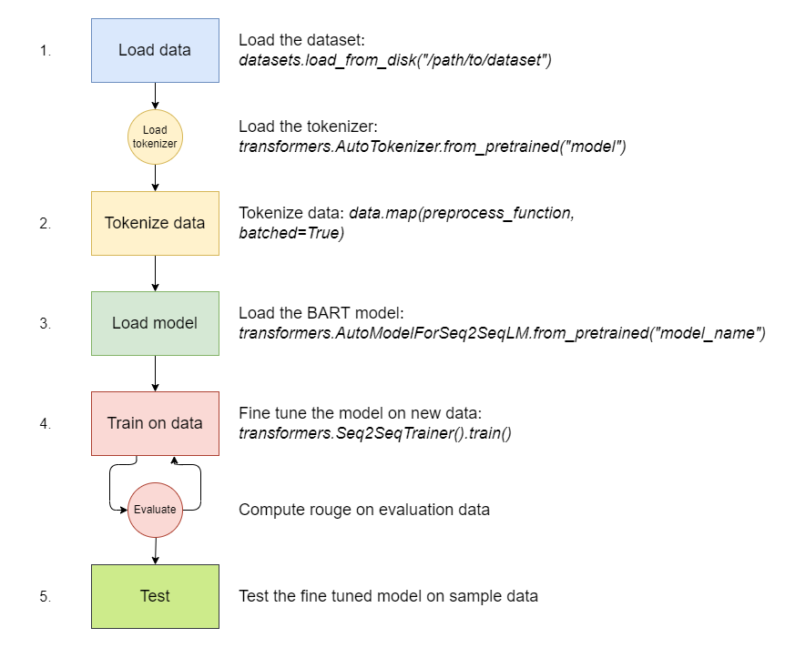
MODEL ARCHITECTURE

Slide 9
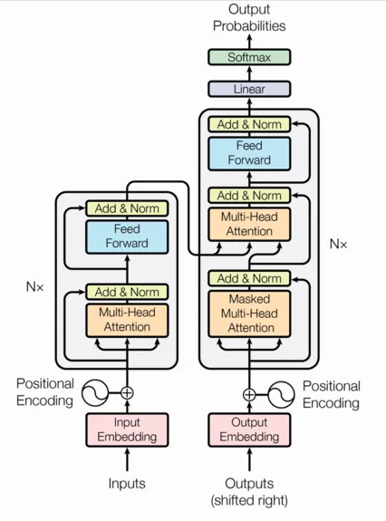
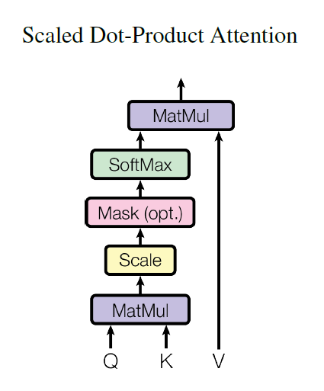
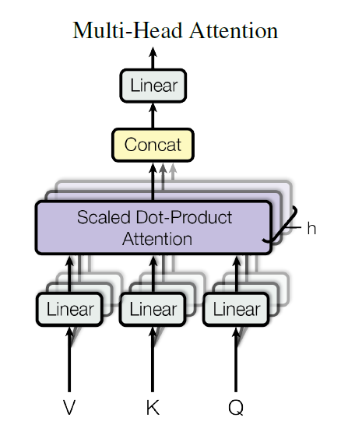
TRANSFORMER ARCHITECTURE
Key Components:
1. Self-Attention Mechanism
2. Multi-Head Attention
3. Positional Encoding
Core Architecture:
1. Encoder-Decoder Structure
2. Utilizes Self-Attention

Slide 10
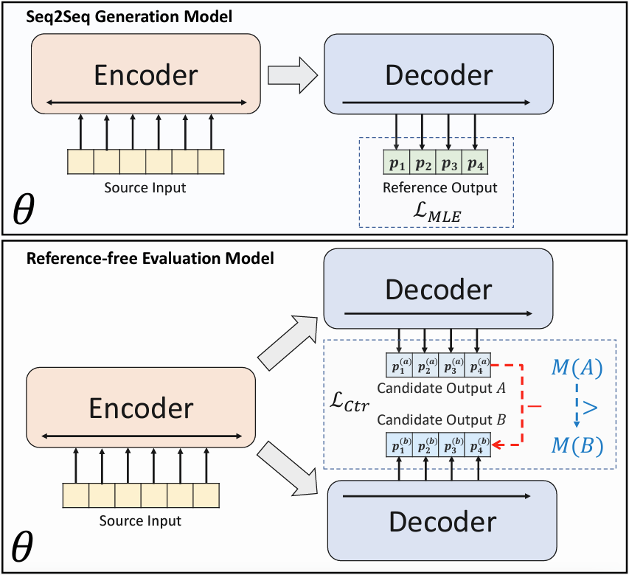
BART ARCHITECTURE

Slide 11
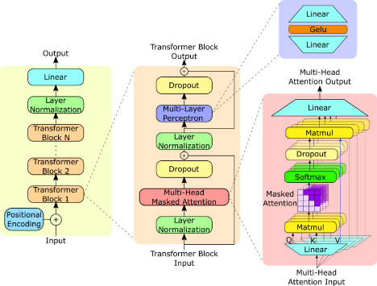
GPT2 ARCHITECTURE

Slide 12
ROUGE SCORE
1. ROUGE (Recall-Oriented Understudy for Gisting Evaluation) metric is used to evaluate the performance of machine-generated summaries against human-written summaries.
2. It calculates the similarity between the generated summary and the reference summary by comparing overlapping n-grams, where n can be 1 (ROUGE-1) or 2 (ROUGE-2).
3. ROUGE-L measures the longest common subsequence, considering the order of words, providing a stricter evaluation.
4. ROUGE-1 focuses on unigrams (single words), while ROUGE-2 considers bigrams (pairs of consecutive words), both indicating the extent of overlap.
5. The higher the ROUGE score (whether ROUGE-1, ROUGE-2, or ROUGE-L), the closer the machine-generated summary aligns with the human-written summary, demonstrating better quality.

Slide 13




ROUGE SCORE RESULT
GPT – 2 model
Facebook/bart model
Before fine-tuning
Before fine-tuning
After fine-tuning
After fine-tuning

Slide 14
Tools and Technologies
Tools and Technologies
Programming Language - pyothn3
Programming framework -Tensorflow, Numpy, Pandas
IDE - Jupyter-notebook - Google Colab - Kaggle Notebook
Source code management - Git

Slide 15
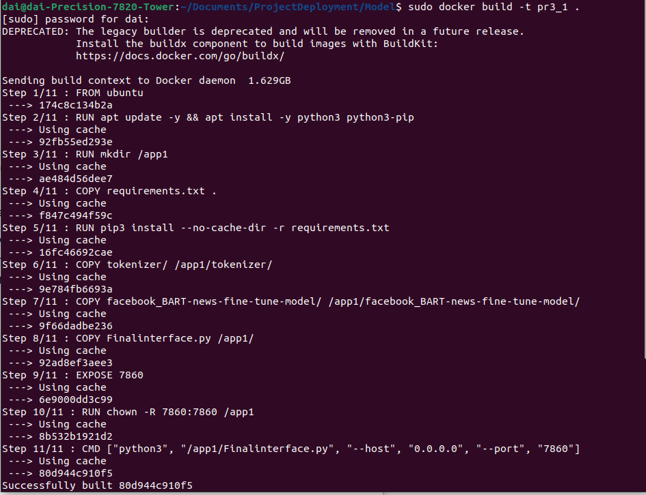
Deployment – Build image
Building the image of the fine-tuned model by using Dockerfile and running it in port 8080 of ec2 instance, t2.2x large, which provided 8 vCPUs, 32 GiB of memory, and 81 CPU credits per hour, It eradicated the error caused while installing PyTorch for t2.micro instance which is a free tier available in instances.

Slide 16
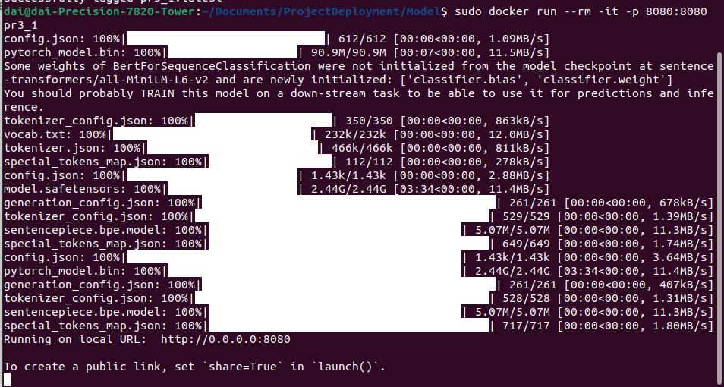
Deployment – Launch model
The Amazon Machine Image (AMI) used is Deep Learning OSS Nvidia Driver AMI GPU PyTorch 2.0.1 (Ubuntu 20.01) 20240130 for running PyTorch libraries in a sophisticated way.
Creating the Image of the html file to run in web address of the ec2 instance created, in which the server running through the image created by using the model was displayed.

Slide 17
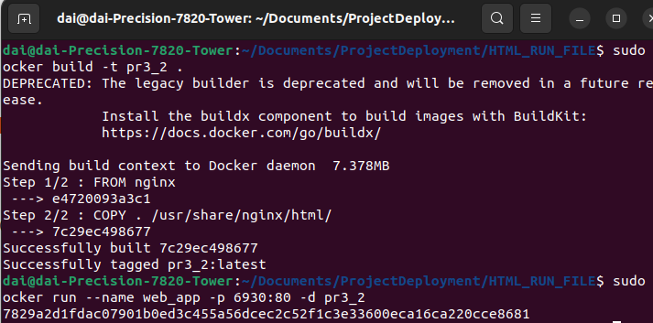
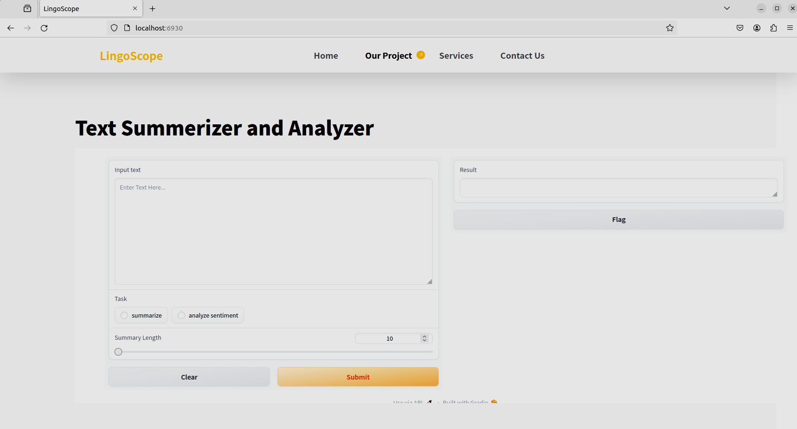
Deployment – Hosting
Container run
Live instance

Slide 18
CONCLUSION
Our project utilizes fine-tuned BART and GPT-2 models for English and Hindi summarization respectively, achieving precise and concise summaries in both languages.
Employing the FLAIR library, we conduct sentiment analysis with accuracy, enabling users to discern the emotional nuances within textual content effectively.
Evaluation using ROUGE scores ensures the quality and alignment of our generated summaries with human-written references.
With our integrated approach, combining advanced models and evaluation metrics, our project offers valuable solutions for text summarization and sentiment analysis needs across languages..

Slide 19
FUTURE SCOPE
In the future, we plan to include more Indian languages in our project, making text summarization and sentiment analysis available to a wider range of people.
We'll improve our system by using advanced techniques that are better suited for Indian languages, which will help make our summaries and sentiment analysis more accurate and relevant.

Slide 20
THANK YOU

